Slide 1
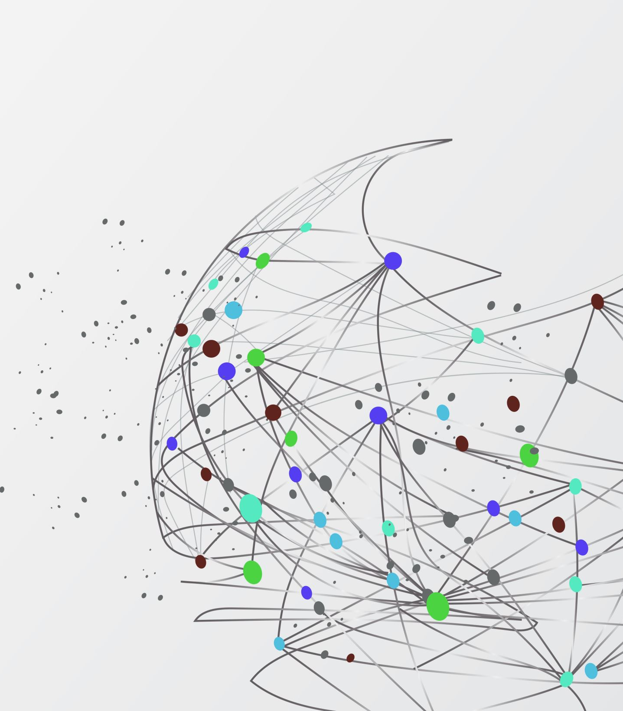
The most interesting training that i ever had.

Slide 2
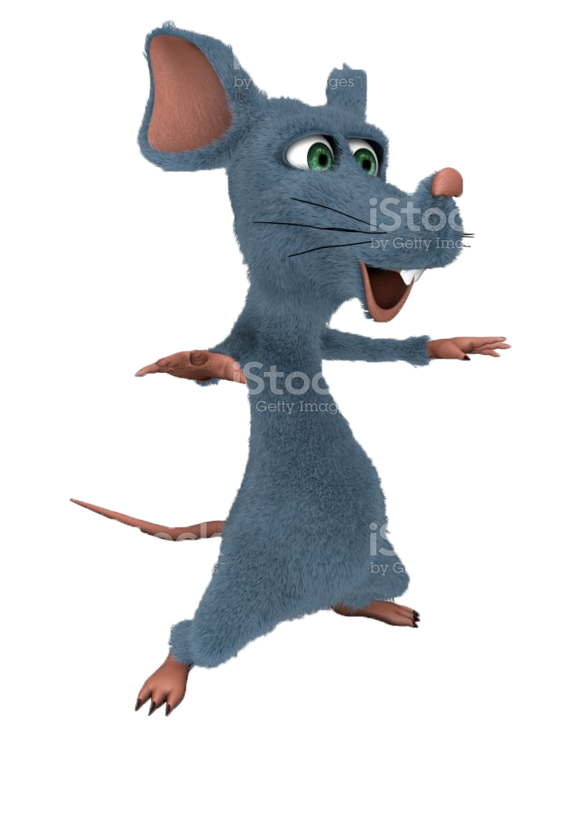
Positive thinking training
One I was on one of those positive thinking trainings and it was wierd af.
There was a guy with a hoe in his hand, and a girl who looked like a hoe
And the room in which this shitstorm was happening in was covered in some kind of brown substance, lets call it S.H.I.T
It was one of wierder placer i ever went to, even the guy that was coaching us was a fucking wierdo

Slide 3
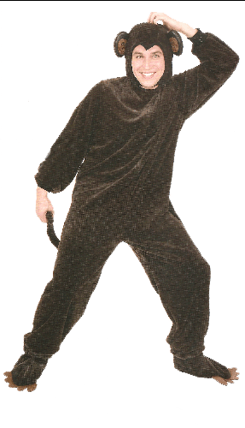
The monkey coach
That wierd fuck thought that dressing in a monkey costume was a great idea…
Shit felt wierd like I was in some kind of mental hospital or like I had some sort of drug induced fever dream
This monkey suit guy started to tell us that life is beutifull and we should not waste it, so of course after saying that the guy with a hoe standing next to a hoe made a suicide joke
All of the sudden 5 buffed up guys walked in and took him backstage, and it was fucking terrifing because one of the guys that took him had his face painted green and was wearing some kind of bootleg shrek costume

Slide 4
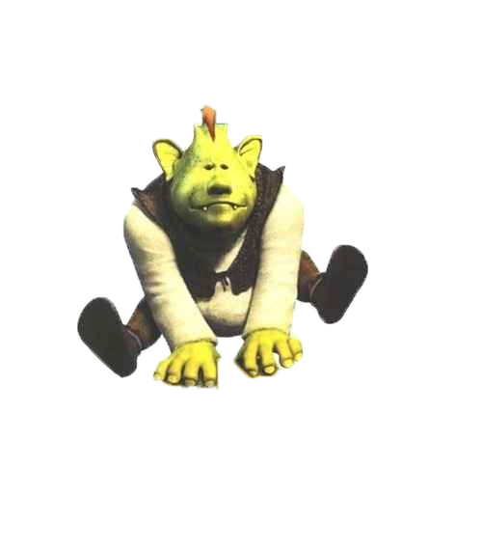
Big green ogre

Slide 5
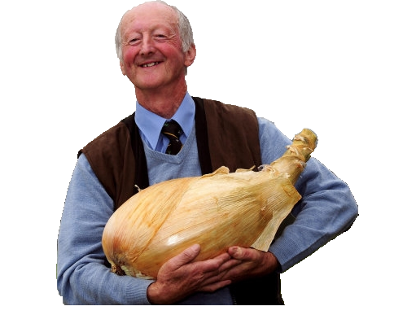
Oniony ending
Some shit bout that people have layers or somehin

